Slide 1
Mentorship & Preceptorship
The Collaborative Process
Jillian Edwards, ARNP, DNc, MN, BSN, RN

Slide 2
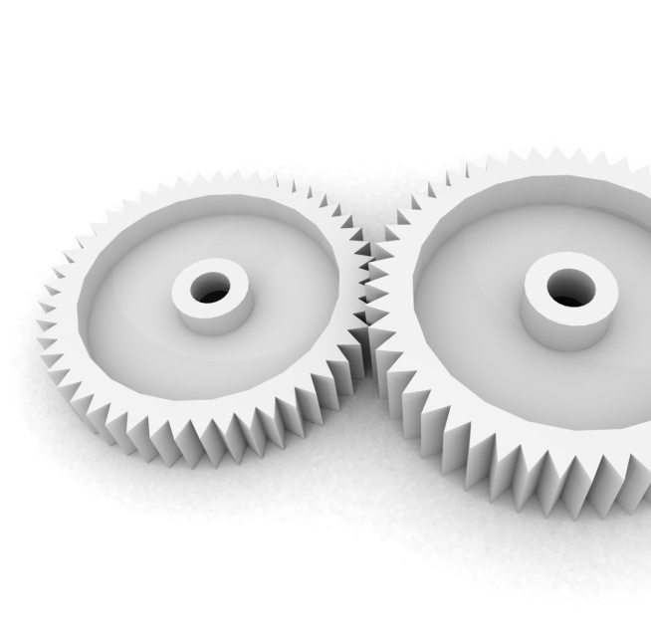
Mentoring and Preceptorship
Describe the differences among mentoring, coaching, and preceptoring
Identify characteristics of effective mentors, mentees, and preceptors
Discuss the types of mentoring relationships

Slide 3
Historical Background
Mentor—from Greek mythology
Wise and faithful advisor to Odysseus (known as Ulysses by Romans)
Mentoring occurs when one person invests time, energy, and personal know-how in assisting the growth and ability of another person (Brown, 2003)
Encourages human growth and potential

Slide 4
What Mentoring Is and Is Not
Is not coaching or precepting
Coaches
Preceptors
1
Coaches help individuals find new ways to solve problems, reach goals, and design a plan of action
2
Preceptors are similar to tutors. Preceptorship pairs a novice with an experienced person for a set period of time focusing on policies, procedures, skill development, and reinforcement

Slide 5
What Mentoring Is and Is Not
Is not coaching or precepting. However a preceptor can become a mentor!
Mentors
Mentors
Are chosen, not assigned
Go the extra mile
Foster mentee’s growth/development over time.
Develop professionally based, nurturing relationship
In nursing, mentor is synonymous with trusted advisor, friend, teacher, guide, & wise person
Focus on needs of mentee
A partnership between two people

Slide 6
What Is a Preceptorship?
Clinical teaching model
Synonymous with the term capstone course
Senior nursing student works with an experienced nurse during the last semester or quarter of school for a specified amount of time
Clinical hours are a requirement and must be met before the student graduates
Also identified as a partnership between an experienced nurse and new graduate nurse
Experienced nurse provides the new graduate nurse with a formalized orientation and training program specific to the area in which he or she is working

Slide 7
How to Be a Mentor
Be open-minded
Be flexible
Be optimistic
Help the preceptee achieve his/her written goals
Common background in education, expertise, or interest
Shares and tells preceptee about self
Ask broad, open-ended questions
Skilled at conflict management and communication

Slide 8
Characteristics of a Successful Mentor
1
Communicates high expectations
Pushes mentees
Allows mentees to learn from failures
Encourages mentees
Embraces conflict
2
Is a good listener
Nonjudgmental listening ear
Respectful listening
Has empathy
Perception of needs
Unselfish teacher
3
Offers encouragement
Values mentee’s experience, ideas, and knowledge
Promotes independence
Is generous
Shares time and knowledge with others

Slide 9
Shared Characteristics of a Preceptor & Mentor
Serve as role models, counselors, and guide to promote novice nurse in career
Provide a supportive atmosphere
Offer constructive feedback
Bolster novice nurse self-confidence

Slide 10
Role of the Mentee
Learn and absorb information provided
Know objectives for developing mentoring relationship
Know their goals
Think how a mentor can help in achieving goals
Think of best way to approach and develop a mentoring relationship

Slide 11
Types of Mentoring Relationships
Formal
Structured
Driven by organizational needs
Effectiveness measured by organization
Informal
Voluntary/flexible
Mutual acceptance of roles
Periodic check-ups by supervisors
Situational
Brief contact
One-time event
Results assessed later
Formal
Situational
Informal

Slide 12
Mentoring + Collaboration = Conflict
Mentoring &
Preceptoring
Collaboration
Whenever individuals interact, mentor, or collaborate, conflict is inevitable. View conflict as a positive step towards change and improved results
Conflict & Resulting Change

Slide 13
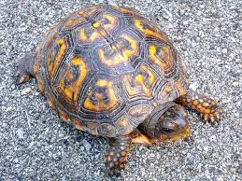
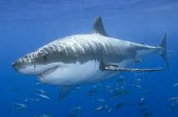
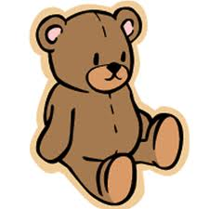
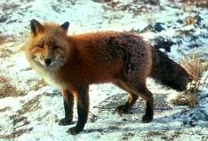
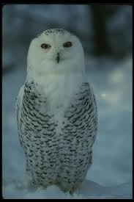
What is your Conflict Management Style?
Withdrawing – Turtle
Forcing - Shark
Smoothing – Teddy
Compromising – Fox
Confronting - Owl

Slide 14
What is your Conflict Management Style?
Withdrawing – Turtle: Avoiding I zig, you zag
Turtles withdraw into their shells to avoid conflicts.
They give up their goals and relationships, they stay away from the issues over which the conflict is taking place and from the persons they are in conflict with.
Turtles believe it is easier to withdraw from a conflict than to face it.

Slide 15
What is your Conflict Management Style?
Forcing – Shark, Competing: I win, you lose
Sharks try to overpower opponents by forcing them to accept their solution to the conflict. Their goals are highly important to them, and relationships are of minor importance.
Sharks seek to achieve their goals at all costs. They are not concerned with the needs of others and do not care if others like or accept them.
Sharks assume that conflicts are settled by one person winning and one person losing. They want to be a winner. Winning gives sharks a sense of pride and achievement.
Losing gives them a sense of weakness, inadequacy and failure. They try to win by attaching, overpowering, overwhelming, and intimidating.

Slide 16
What is your Conflict Management Style?
Smoothing –Teddy Bear Accommodating I lose, you win
To Teddy Bears, the relationship is of great importance while their own goals are of little importance.
Teddy Bears want to be accepted and liked by others. They think that conflict should be avoided in favor of harmony and that people cannot discuss conflicts without damaging relationships.
They are afraid that if the conflict continues, someone will get hurt and that would ruin the relationship. Teddy Bears say “I’ll give up my goals and let you have what you want, in order for you to like me.”
Teddy Bears try to smooth over the conflict out of fear of harming the relationship.

Slide 17
What is your Conflict Management Style?
Compromising – Fox: You bend, I bend
Foxes are moderately concerned with their own goals and their relationship with others.
Foxes seek a compromise; they give up part of their goals and persuade the other person in a conflict to give up part of their goals.
They seek a conflict solution in which both sides gain something; the middle ground between two extreme positions.
They are willing to sacrifice part of their goals and relationships in order to find agreement for the common good.

Slide 18
What is your Conflict Management Style?
Confronting – Owl: Collaborator, I win, you win
Owls highly value their own goals and relationships. They view conflict as a problem to be solved and to seek solution that achieves both their goals and the goals of the other person.
Owls see conflicts as a means of improving relationships by reducing tensions between two persons. They try to begin a discussion that identifies the conflict as a problem. By seeking solutions that satisfy both themselves and the other person, owls maintain the relationship.
Owls are not satisfied until a solution is found that achieves their goals and the other person’s goals. They are not satisfied until the tensions and negative feelings have fully resolved.

Slide 19
Conflict Management Style
No one style fits in every set of circumstances.
Having a repertoire is the most flexible and effective strategy.
Conflict is everyone’s responsibility as different people speak to the issue, many more possibilities emerge – speaks to valuing diversity and avoiding Group Think.

Slide 20
Confronting and Managing Conflict
Use the WIN model!!!
W – When you….
I - I feel….
N - I need…or want…
Variation: I feel…
When…
I want…
Because…

Slide 21
In Conflict Resolution
There is:
No labeling, no name calling, no blame, no kitchen sinking, no defensiveness or habit habitual apologies – these do not contribute to the growth of the mentor/mentee relationship.

Slide 22
Conflict and Anger
Many deny it, fear it.
It is actually a source of strength and energy.
Clue that something different needs to happen.
Time to equalize power imbalances.
Signal – step away from the situation to think about what needs to change.

Slide 23
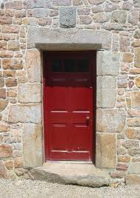
Fear
Like a dot or doorway
Options:
Protect, armor ourselves, iron heart
Notice and smile, experience
vulnerabilities, help ourselves
and others

Slide 24
Fear
Uncertainty is more frightening than physical pain
We are doubting ourselves, not trusting ourselves, not loving ourselves, not respecting ourselves

Slide 25
Fear
When you are open to not feeling ok – and allow yourself to look at what hurts – you develop courage, fearlessness, and the capacity to love and care about other people.

Slide 26
Mentoring Through Conflict & Reality Shock
Honeymoon phase
Listen and understand
Act as intermediary
Shock or rejection phase
Encourage mentee to discuss feelings of disillusionment and frustration
Share own personal transition process
Recovery phase
Maintain open channels of communication
Encourage mentee to try new things
Resolution phase
Reinforce positive qualities of mentee
Encourage mentee to problem-solve issues regarding professional goals

Slide 27
Self Reflection
Questions or curious for more?
Review the Conflict Management & Resolution module
Complete the Conflict Management Style Self Assessment

