Slide 1
Chapter 10: Managing Successful Products, Services, and Brands
BUS 140
Y.Williams

Slide 2
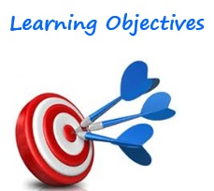
Learning Objectives
Explain the product life-cycle concept
Identify ways that marketing executives manage a product’s life cycle
Recognize the importance of branding and alternative branding strategies
Describe the role of packaging and labeling in the marketing of a product
Recognize how the 5P’s framework is expanded in the marketing of services (We will discuss 6P’s)

Slide 3
Terms to Know
Product Life Cycle: describes the stages a new product goes through in the marketplace: introduction, growth, maturity, and decline.
Product Class: refers to the entire product category or industry
Product Form: pertains to variations of a product within the product class
Product Modification: involves altering one or more of a product’s characteristics, such as its quality, performance, or appearance, to increase the product’s value to customers and increase sales
Market Modification: strategies by which a company tries to find new customers, increase a product’s use among existing customers or create a new use situation.

Slide 4
Terms Cont.
Trading up: adding value to the product (or line) through additional features or higher-quality materials.
Trading Down: reducing a product’s number of features, quality, or price.
Branding: a marketing decision in which an organization uses a name, phrase, design, symbols, or combination of these to identify its products and distinguish them from those of competitors.
Brand Name: any word, device (design, sound, shape, or color), or combination of these used to distinguish a seller’s products or services
Brand Personality: a set of human characteristics associated with a brand name
Brand Equity: the added value a brand names gives to a product beyond the functional benefits provided.

Slide 5
Charting the Product Life Cycle

Slide 7
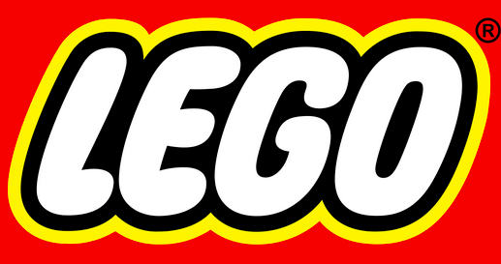
Managing the Product Life Cycle
Role of a Product Manager – Sometimes called the Brand Manager, manages the marketing efforts for a close-knit family of products or brands. These individuals are responsible for managing a product through all the stages of the life cycle
Modifying the Product – A common approach to product modification is to increase a products value to consumers and its called Product Bundling. The sale of two or more separate products in one package.
Modifying the Market – Finding new customers by offering new product lines, increasing a products use, or creating a new product situation.
Repositioning the Product – Often a company decides to reposition tis product or product line in an attempt to bolster sales. This can be accomplished by 1.) Changing the Value offered 2) Reaction to a competitor’s position 3.) Reaching a New Market or 4.) Catching a Rising Trend

Slide 8
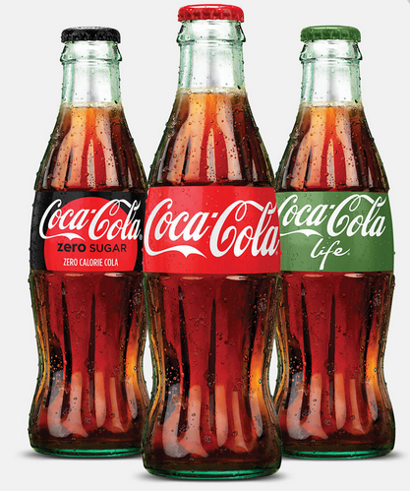
Branding & Brand Management

Slide 10
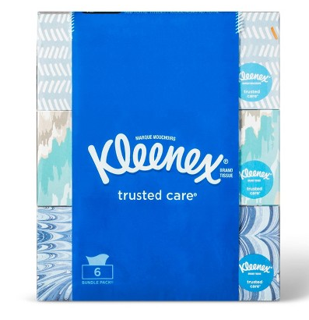
Steps to Creating Brand Equity
Step 1: Develop a positive brand awareness and association in the mind of the consumer
Step 2: Establish the brand meaning in the mind of the consumers. What does the brand stand for? (Performance or Imagery related)
Step 3: Elicit proper consumer response to your product’s identity and meaning. How doe people think and feel about your product/service?
Step 4: Create a consumer brand connection that leads to an active loyalty relationship.

Slide 11
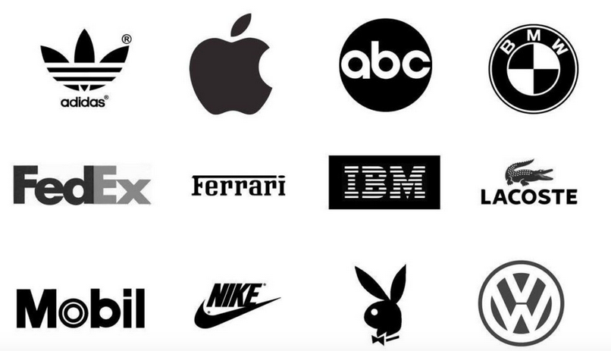
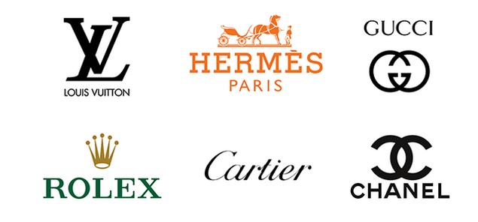
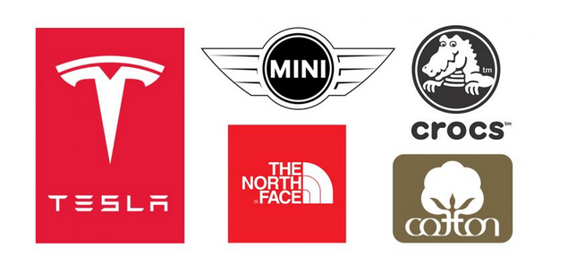
Can you recognize these? If so, the company has done a great job of branding and building exclusivity with their product and service.

Slide 12
Alternative Branding Strategies

Slide 13
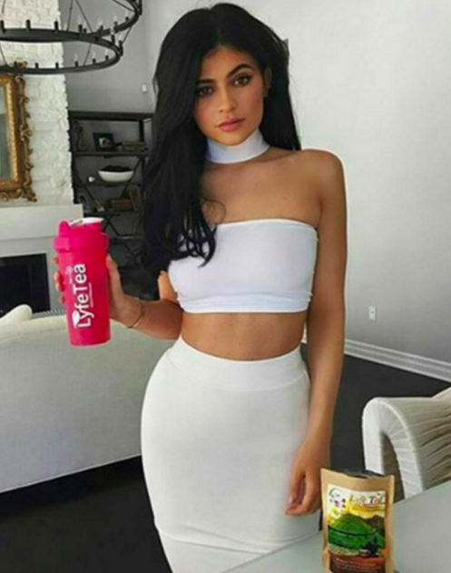
Terms to Know
Brand Licensing: A contractual agreement whereby one company (licensor) allows its brand name(s) or trademark(s) to be used with products or services offered by another company (licensee( for a royalty of fee.

Slide 14
Multiproduct branding: a branding strategy in which a company uses one name for all its products in a product class.

Slide 15
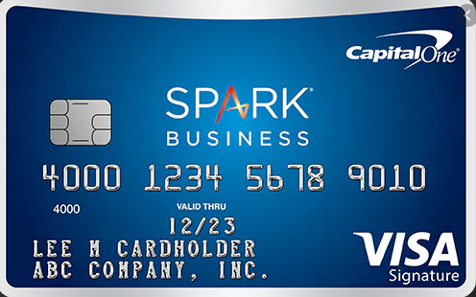
Multi-branding: a branding strategy that involves giving each product a distinctive name when each brand is intended for a different market segment

Slide 16
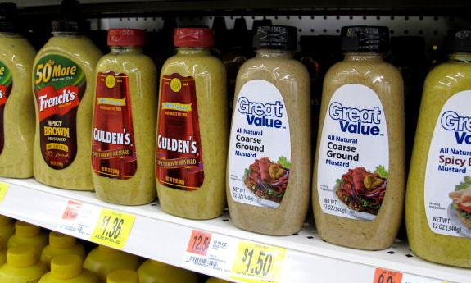
Private Branding: a branding strategy used when a company manufactures products but sells them under the brand name of a wholesaler or retailer. Also called private labeling or reseller branding.

Slide 17
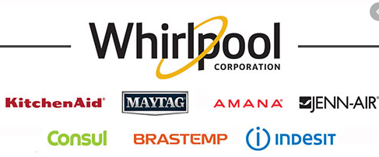
Mixed Branding: A branding strategy where a firm markets products under its own name(s) and that of a reseller because the segment attracted to the reseller is different from its own market.

Slide 18
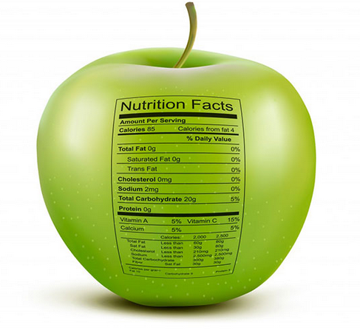
Packaging and Labeling Products
Packaging: a component of a product that refers to any container in which it is offered for sale and on which label information is conveyed.
Label: An integral part of the package that typically identifies the product or brand who make it, where and when it was made, how it is to be used, and package contents and ingredients.

Slide 19
Benefits and Challenges
Benefits: Communication, Functional, and Perceptual
Challenges: Connection to Customers, Environment, Health/Safety/and Security, Cost Reduction

Slide 20
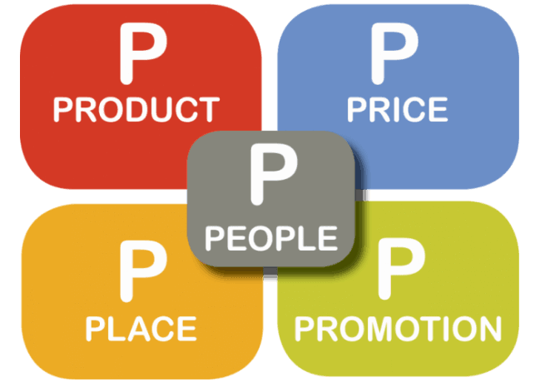
5P’s of Marketing
Yes, I recognize your book references 7 P’s but we’re going to cover the basic 5 and then 1 that I feel should be added to the mix and isn’t (but is just as important)
1.) Product (Service)
2.) Price
3.) Placement
4.) Promotion
5.) People
6.) Personalization

Slide 21
Product or Service
From the reading, you found out that the concept of the product doesn’t change when thinking of products or services – the concept of a tangible “something” is constant. However when discussing services you have to focus on exclusivity and brand name.
Brand names help make the abstract nature of services more concrete.

Slide 22
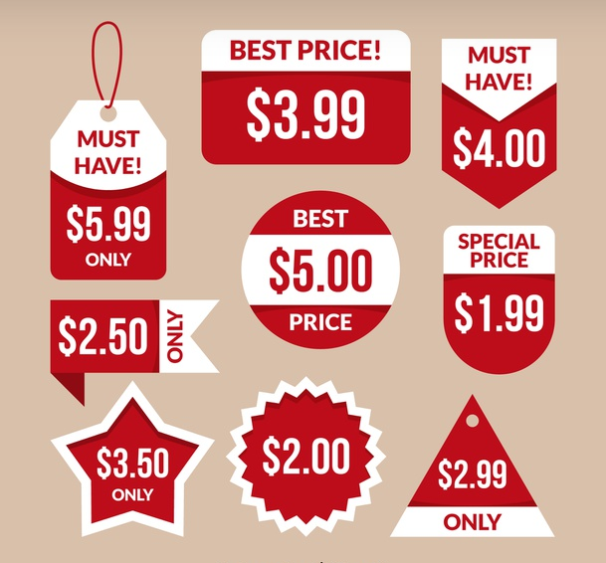
Price
Price can be referred to in various ways; charges, fees, rates, and fares. But regardless of the term, prices places two (2) essential roles: 1.) to affect consumer perceptions and 2.) to be used in capacity management.
Capacity Management: Integrating the service component of the marketing mix with the efforts to influence demand.
When there are few cues by why which to judge the quality of a product or service, consumers use price.

Slide 23
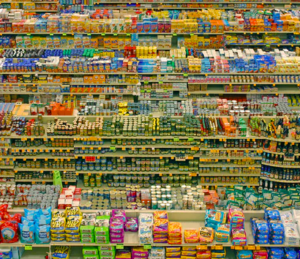
Place
Placement of a product or its distribution is a major factor in developing a service marketing strategy. Why? Because of the inseparability of services from the producer.
But as competition grows, the value convenience is heightened.

Slide 24
Check out this Article

Slide 25
Promotion
The purpose of promotion for services, specifically advertising, is to show the benefits of using the service. It is valuable to stress availability, location, consistent quality, and efficient, courteous service.
Publicity: is another form of promotion. It plays a major role in the promotional strategy of nonprofit services and some professional organizations.
PSA’s Public Service Announcements are free and help nonprofits because of their heavy reliance on publicity to disseminate their messages.

Slide 26
The use of Social Media has impacted how business promote products to consumers

Slide 27
People
Many services depend on people for the creation and delivery of the customer service experience.
Perception plays a big role in how business market products/services. As customers will often judge the quality of the experience based on the service they received.
Disneyland does an excellent job of building an Experience for its consumers

Slide 28
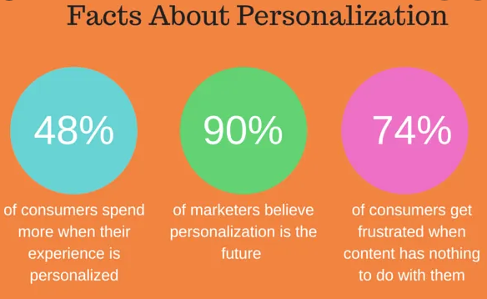
Personalization
Continuing on the back of People and companies creating experiences is the Personalization end to marketing. Consumers WANT to feel special and the more special you can make someone feel, the more likely they will be to frequent your store, return and bring someone else with them.
Excellent Example of Customer Personalization and Customer Service.

